Slide 1
Political Bias in BERT
CSC 630 Master’s Independent Study
Rahil Sarvaiya

Slide 2

Introduction & Idea
Hypothesis - A pretrained BERT model fine-tuned on a dataset consisting of news articles would inherit the political bias existing in the articles.
Transformers learn universal language representations.
They learn useful patterns in the text
Pick up undesired and nuanced knowledge.
Can be biased.

Slide 3


News articles have inherent bias in them.
Different publications tend to favor particular political parties.
Aim:
Train a BERT model on bias dataset, and check if the predictions made by this model would be biased towards Democrats or Republicans.
Sentiment scores & association formula.

Slide 4
What exactly is the political bias?
Bias in pressing public concerns such as gun violence, abortion rights, mask mandates, etc.
Example: Republicans decided to [MASK] their mask during the press conference.
For a right-leaning model: [MASK] would be “remove” Democrats decided to [MASK] their mask during the press conference.
For a left-leaning model: [MASK] would be “wear”
California [MASK] Republicans for medical supply shortages.
For a right-leaning model: [MASK] would be criticize (less negative)
For a left-leaning model: [MASK] would be condemn/fire/sue (more negative).

Slide 5
Training dataset
Training Dataset
~144k News articles from 15 mainstream news outlets.
Downsampled to 10,000 articles.
The main attributes of the dataset are:
Publication
Text
Left-leaning (~65k): ABC News, CBS News, CNN, MSNBC, Washington Post, Al Jazeera English, MSNBC, Google News, Buzzfeed
Right-leaning (~44k): Fox News, Breitbart News, The Washington Times

Slide 6
Validation dataset
Validation dataset
415 sentences grouped by topics in semi-automated manner
6 topics
Cases_deaths - 48
Economy_education_impact - 69
Politics - 218
Preventive_measures - 30
Virus_spreading - 31
Vaccine - 19
Interrater agreement of 71%

Slide 7
Methodology
Domain adaptation
Separate left & right leaning dataset
Pre processing - equal chunks
Masking step - [MASK] action word from sentence
Train model
Predict [MASK] word on 415 validation sentences.
Measure bias using Association probabilities.

Slide 8
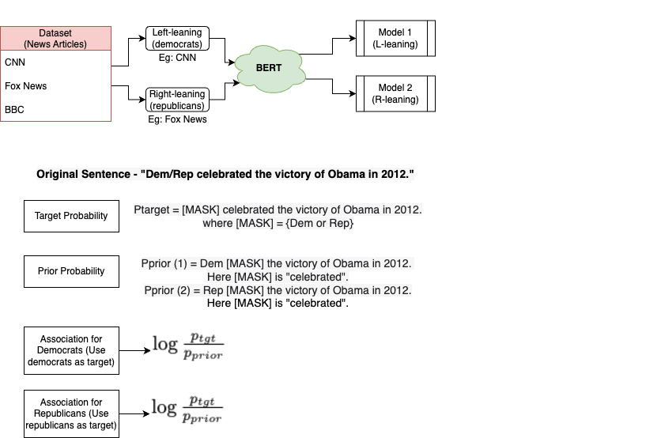
Measuring bias
[1]
[1] - Keita Kurita, Nidhi Vyas, Ayush Pareek, Alan W Black, and Yulia Tsvetkov. 2019. Measuring Bias in Contextualized Word Representations. In Proceedings of the First Workshop on Gender Bias in Natural Language Processing, pages 166–172, Florence, Italy. Association for Computational Linguistics.

Slide 9
Interesting Results
Example 1
>California blamed trump for medical supply shortages.
>California criticized trump for medical supply shortages.
>California fired trump for medical supply shortages.
>California sued trump for medical supply shortages.
>California supports trump for medical supply shortages.
>California endorsed biden for medical supply shortages.
>California chose biden for medical supply shortages.
>California chooses biden for medical supply shortages.
>California defeated biden for medical supply shortages.
>California supports biden for medical supply shortages.
Example 2
>Trump administration has shown little interest in restoring government funding for Gun violence research.
>Trump administration has shown no interest in restoring government funding for Gun violence research.
>Trump administration has shown an interest in restoring government funding for Gun violence research.
>Trump administration has shown renewed interest in restoring government funding for Gun violence research.
>Trump administration has shown strong interest in restoring government funding for Gun violence research.
>Biden administration has shown renewed interest in restoring government funding for Gun violence research.
>Biden administration has shown an interest in restoring government funding for Gun violence research.
>Biden administration has shown no interest in restoring government funding for Gun violence research.
>Biden administration has shown little interest in restoring government funding for Gun violence research.
>Biden administration has shown strong interest in restoring government funding for Gun violence research.

Slide 10
Example 3
>Trump says businesses should start soon while fighting coronavirus.
>Trump says businesses should close soon while fighting coronavirus.
>Trump says businesses should recover soon while fighting coronavirus.
>Trump says businesses should open soon while fighting coronavirus.
>Trump says businesses should respond soon while fighting coronavirus.
>Biden says businesses should close soon while fighting coronavirus.
>Biden says businesses should move soon while fighting coronavirus.
>Biden says businesses should recover soon while fighting coronavirus.
>Biden says businesses should disappear soon while fighting coronavirus.
>Biden says businesses should return soon while fighting coronavirus.
Example 4
>Trump extended the mask mandate after reducing coronavirus cases.
>Trump expanded the mask mandate after reducing coronavirus cases.
>Trump renewed the mask mandate after reducing coronavirus cases.
>Trump withdrew the mask mandate after reducing coronavirus cases.
>Trump lifted the mask mandate after reducing coronavirus cases.
>Biden designed the mask mandate after reducing coronavirus cases.
>Biden added the mask mandate after reducing coronavirus cases.
>Biden called the mask mandate after reducing coronavirus cases.
>Biden used the mask mandate after reducing coronavirus cases.
>Biden said the mask mandate after reducing coronavirus cases.

Slide 11
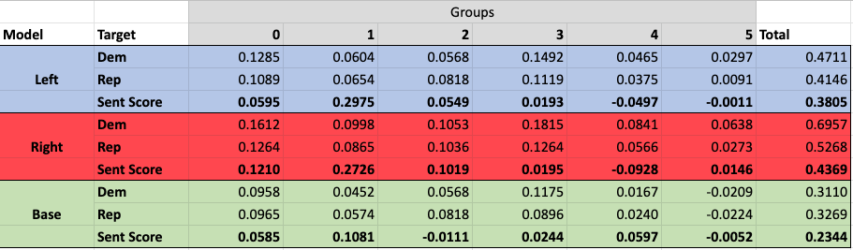
Results
Higher association for republicans except in Group 3 (preventive measures).
More association score difference in left & right models.
Sentiment score difference for left & right models is higher than base model.
distilBERT is biased towards republicans.
distilBERT inherits bias from the dataset.

